Slide 1

Disaster Route Planning
MGSC 662 – Group Project
By: Group 3 – Arnav G., Om S., Nandani Y., Michael M., Lakshya A.

Slide 2

Problem Statement
In urban areas, natural and man-made disasters present significant challenges, requiring effective planning and rapid response.
While existing city infrastructures are typically robust, they may not be adequately prepared for the intense and sudden demands brought about by such emergencies
This highlights the need for systems capable of anticipating and adapting to the dynamic nature of disaster scenarios.

Slide 3
Problem Statement
In urban areas, natural and man-made disasters present significant challenges, requiring effective planning and rapid response.
While existing city infrastructures are typically robust, they may not be adequately prepared for the intense and sudden demands brought about by such emergencies
This highlights the need for systems capable of anticipating and adapting to the dynamic nature of disaster scenarios.
Variation of the Travelling Salesman Problem (TSP)

Slide 4
Evolving the TSP
Increasing complexity
Focus of this model
Travelling Salesman Problem (TSP)
Optimize the shortest path for a single route covering all points and returning to the start
Vehicle Routing Problem (VRP)
Expands to multiple vehicles, each starting and ending at a central depot, serving multiple locations
Optimizes routes for a fleet, without specific capacity constraints per vehicle
Capacitated Vehicle Routing Problem (CVRP)
Introduces vehicle capacity constraints, blending route optimization with load management
Focuses on balancing shortest paths and capacity limits for each vehicle

Slide 5
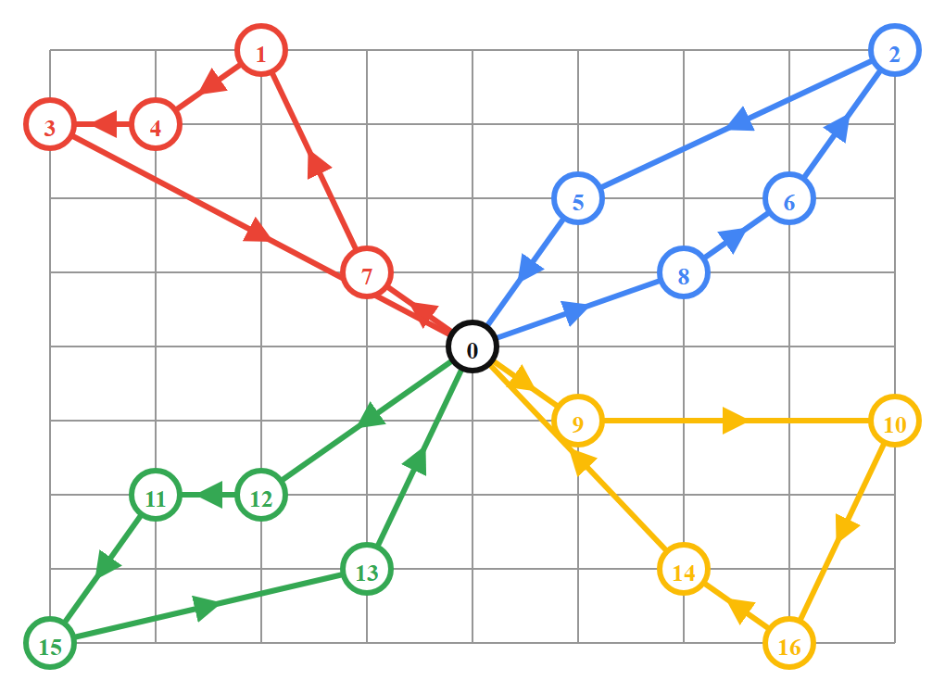
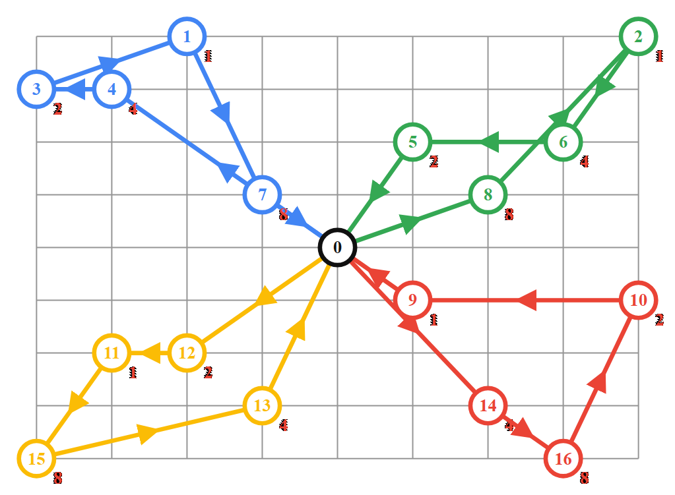
Evolving the TSP
Vehicle Routing Problem (VRP)
Capacitated Vehicle Routing Problem (CVRP)

Slide 6
Data collection and preparation
General Transit Feed Specification (GTFS) from STM
This data contains detailed geospatial information about bus stops across routes
The data was cleaned and preprocessed to ensure compatibility with the modelling environment
OpenStreetMap + NetworkX (OSMnx)
This Python library was used to calculate the approximate on-road distance between any two given stops using their latitude/longitudes
A subset of stops on high frequency lines was extracted and saved for further usage

Slide 7
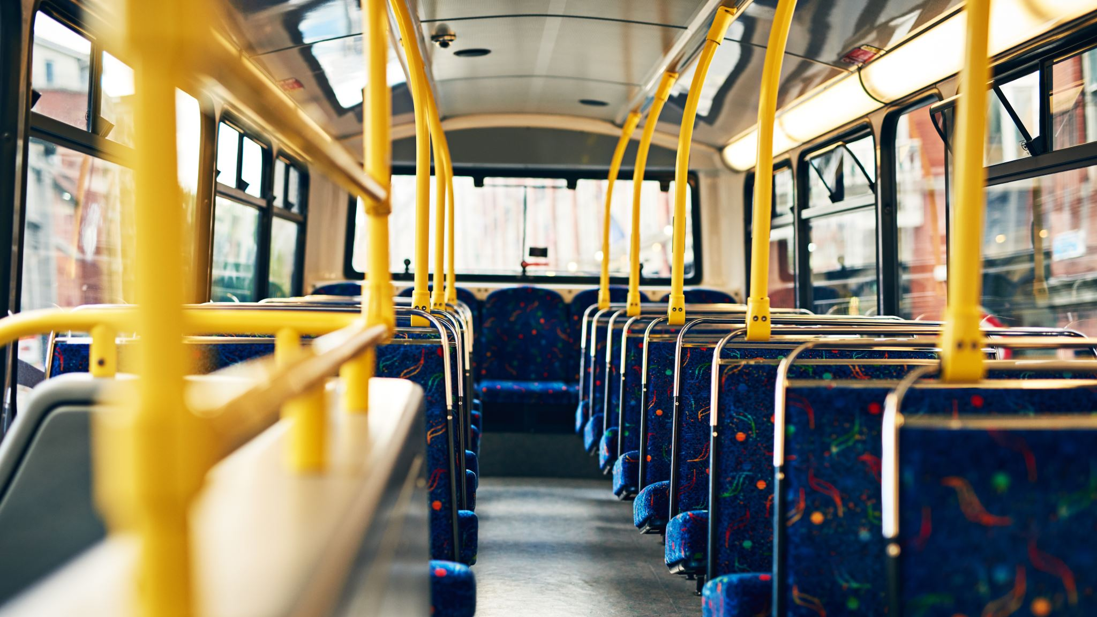
Mathematical formulation Problem Statement
Given a set of bus stops with a defined passenger demand, a depot node, and a disaster area, what route should each bus follow to minimize the total distance travelled across the network, while not exceeding the bus capacity?

Slide 8
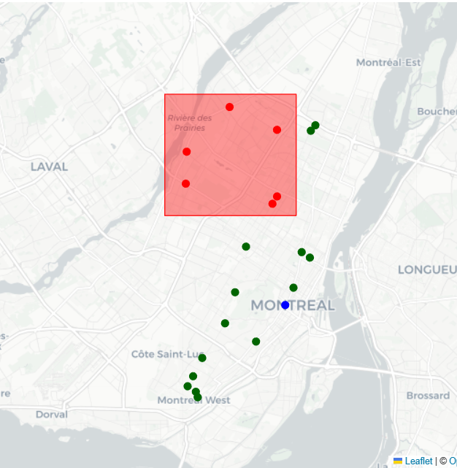

Mathematical formulation Parameters
Disaster area
$S=\left\{0,1,2,…n\right\}$ represents the set of bus stops
The depot (start and end point) is given by node 0
The disaster area is represented as a rectangle governed by 4 latitude/longitude points
The distance matrix $D_{ij}$ gives the distance between nodes $i$ and $j$
Depot

Slide 9

Mathematical formulation Parameters
Disaster area
The demand vector $q \sim U\left(L,H\right)$ gives the passenger demand at node $i$
The capacity of each bus is given by $Q$
The number of available buses is $K$
The distance threshold between two non-depot nodes is given by $D_{max}$
Depot

Slide 10

Mathematical formulation Decision variables
$x_{ijk}= \left\{\begin{aligned}1 \text{if} \text{bus} k \text{travels} \text{from} \text{node} i \text{to} \text{node} j \\ 0 \text{otherwise}\end{aligned}\right.$
$u_{i}= \text{amount} \text{of} \text{demand} \text{satisfied} \text{at} \text{node} i$

Slide 11


Mathematical formulation Objective function and constraints
Minimize total distance travelled
Each bus leaves node it enters
Each node is visited only once
Each bus leaves depot at most once
Capacity of bus is not exceeded
No travel between same nodes
MTZ subtour elimination
Distance between non-depot nodes
$x_{ijk}$ is binary, $u_{i}$ is integer

Slide 12
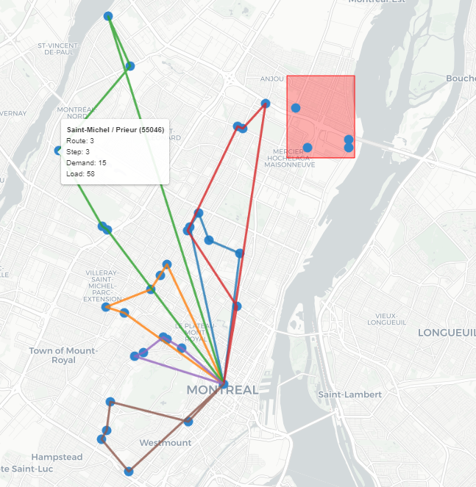
Solving the CVRP
Stop details
The given map shows a solution to a sample CVRP problem using the defined formulation.
We see multiple buses starting from the depot and following separate routes to satisfy the entire network’s demand and coming back to the depot.
Different colored lines highlight different routes.
The area in red is the “disaster area” with disabled nodes.
Depot

Slide 13

Evolving the CVRP
$$q_{i}≤Q ∀ i∈\{0, 1, 2, …n\}$$
𝑞_𝑖≤𝑄 ∀ 𝑖∈{0, 1, 2, …𝑛}
Model works, feasible solutions can be found
$$q_{i}>Q \text{for} \text{any} i∈\{0, 1, 2, …n\}$$
𝑞_𝑖>𝑄 "for any" 𝑖∈{0, 1, 2, …𝑛}
Model is infeasible, no solutions are found.
The demand at any node $i$ is given by $q_{i}$ and the capacity of the bus is given by $Q$
What happens if the demand at a stop exceeds the capacity?
We get a constraint conflict between visiting every node (2.3) and visiting a node if demand can be satisfied (2.5)

Slide 14
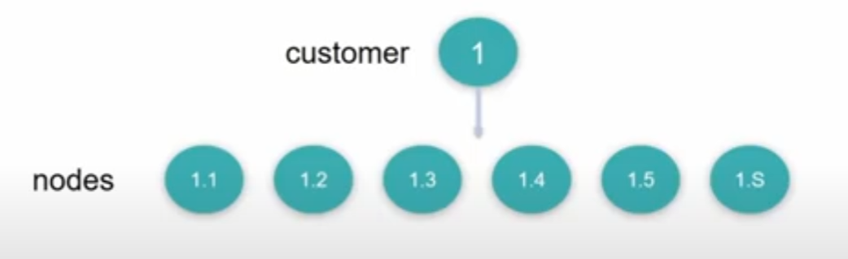

Split Delivery VRP (SD-VRP)
To solve the problem, we introduce a series of algorithms to convert the CVRP into a SD-VRP.
The idea is to split each node with excess demand ($q_{i}>Q$) into multiple nodes with smaller demand.
By doing so, the scale of the problem increases, but we are still able to solve it using the same ideas developed earlier.
The distance between the new nodes for the same bus stop is set at 0.

Slide 15
Examples of splitting a node
Geometric
Capacity
Random
$$q_{i}=97$$
𝑞_𝑖=97
$$q_{i1}=1$$
𝑞_𝑖1=1
$$q_{i2}=3$$
𝑞_𝑖2=3
$$q_{i3}=6$$
𝑞_𝑖3=6
$$q_{i4}=12$$
𝑞_𝑖4=12
$$q_{i5}=24$$
𝑞_𝑖5=24
$$q_{i6}=51$$
𝑞_𝑖6=51
$$q_{i}=97$$
𝑞_𝑖=97
$$q_{i1}=75$$
𝑞_𝑖1=75
$$q_{i2}=22$$
𝑞_𝑖2=22
$$q_{i}=97$$
𝑞_𝑖=97
$$q_{i1}=12$$
𝑞_𝑖1=12
$$q_{i2}=74$$
𝑞_𝑖2=74
$$q_{i3}=11$$
𝑞_𝑖3=11

Slide 16



Examples of splitting a node
Geometric
Capacity
Random
$$q_{i}=97$$
𝑞_𝑖=97
$$q_{i1}=1$$
𝑞_𝑖1=1
$$q_{i2}=3$$
𝑞_𝑖2=3
$$q_{i3}=6$$
𝑞_𝑖3=6
$$q_{i4}=12$$
𝑞_𝑖4=12
$$q_{i5}=24$$
𝑞_𝑖5=24
$$q_{i6}=51$$
𝑞_𝑖6=51
$$q_{i}=97$$
𝑞_𝑖=97
$$q_{i1}=75$$
𝑞_𝑖1=75
$$q_{i2}=22$$
𝑞_𝑖2=22
$$q_{i}=97$$
𝑞_𝑖=97
$$q_{i1}=12$$
𝑞_𝑖1=12
$$q_{i2}=74$$
𝑞_𝑖2=74
$$q_{i3}=11$$
𝑞_𝑖3=11

Slide 17
Examples of splitting a node
Geometric
Capacity
Random
$$q_{i}=97$$
𝑞_𝑖=97
$$q_{i1}=1$$
𝑞_𝑖1=1
$$q_{i2}=3$$
𝑞_𝑖2=3
$$q_{i3}=6$$
𝑞_𝑖3=6
$$q_{i4}=12$$
𝑞_𝑖4=12
$$q_{i5}=24$$
𝑞_𝑖5=24
$$q_{i6}=51$$
𝑞_𝑖6=51
$$q_{i}=97$$
𝑞_𝑖=97
$$q_{i1}=75$$
𝑞_𝑖1=75
$$q_{i2}=22$$
𝑞_𝑖2=22
$$q_{i}=97$$
𝑞_𝑖=97
$$q_{i1}=12$$
𝑞_𝑖1=12
$$q_{i2}=74$$
𝑞_𝑖2=74
$$q_{i3}=11$$
𝑞_𝑖3=11
The choice of the splitting technique impacts:
The number of new nodes created
The scale of the model
The time it takes to find an optimal solution

Slide 18

Let’s see it in action!
Open Streamlit

Slide 19
Implications
Remarkable Flexibility
Offers remarkable flexibility in the business value proposition as the approach can be switched based on any GTFS feed.
Transcends Specific Disaster Types
Transcends the confines of specific disaster types.
Enables dynamic customization of affected areas.
Wide-Ranging Market Audience
Local government agencies responsible for public safety and emergency management.
Disaster response organizations, including NGOs and relief agencies.
Urban planners and developers dedicated to crafting resilient urban infrastructures.
Technology integrators specializing in innovative smart city solutions.
Indispensable for Urban Planners and Developers
Design cities that are better equipped for emergency responses.
Training and Simulation
Can be used for training purposes.
Allows city planners and emergency responders to simulate different disaster scenarios.
Helps refine evacuation strategies.
This includes planning road networks, bus routes, and shelter locations in a way that maximizes efficiency during evacuations.

Slide 20
Future improvements
Real-time Data and Dynamic Feeds
Incorporate real-time traffic flow, and weather conditions into the model. This would allow for more accurate and timely adjustments to evacuation routes, improving efficiency and safety.
Scalability Solutions
Develop and implement more efficient algorithms or employ parallel computing techniques to handle larger datasets. This would reduce runtime and allow the model to scale effectively for larger urban areas with more complex transit networks.
Multi-modal Transportation Integration
Expand the model to include other forms of transportation, such as trains, ferries, and foot traffic. This would provide a more comprehensive evacuation strategy that accommodates different needs and scenarios

Slide 21
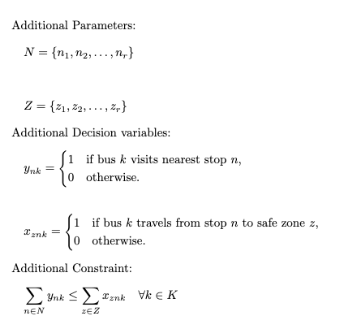




Problem Extension – Safe Zones
We introduce the concept of “safe zones” and the incorporation of nearest stops to disaster areas.
This extension is a scenario where access to the disaster area is not possible. Individuals in the disaster area move to the nearest stop, buses then transport them to a safe zone as they need to evacuate the disaster area.
A new set $N$ representing nearest stops to disaster area
A new set $Z$ representing the safe zones
Binary decision variable $y$ indicating if bus $k$ visits nearest stop $n$
Binary decision variable $x$ indicating if bus $k$ travels to safe zone $z$
Routing constraint to ensure that buses visiting a stop in $N$ also visit at least 1 safe zone

Slide 22
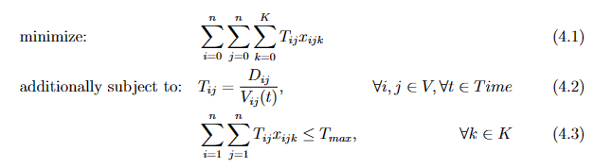
Problem Extension – Minimum Time
In a real-world scenario, especially during a disaster, time becomes a more critical factor.
We can also explore another extension in the future where we aim to minimize the total time taken for evacuation, incorporating real-time traffic flow data from sources like Google Maps, Waze, and local traffic systems to estimate travel times more accurately.
Minimize the total time taken across all buses
Time taken between two nodes is distance over average speed
Time limit on travel between two non-depot nodes

Slide 23

Thank you! Questions?

Slide 24
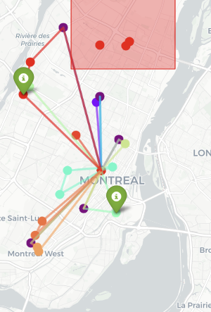
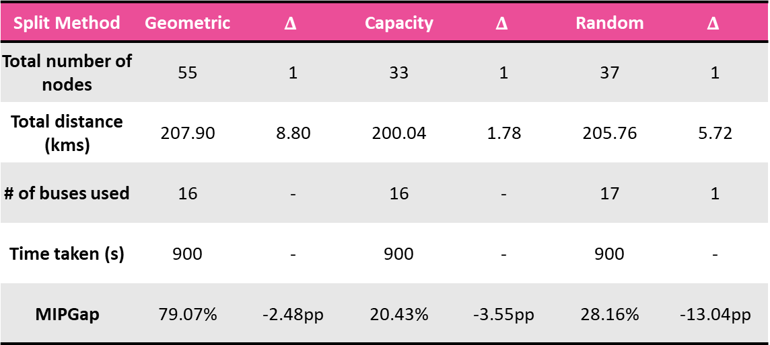
Safe Zone - Results
Split Method | Geometric | $$Δ$$ | Capacity | $$Δ$$ | Random | $$Δ$$
Total number of nodes | 55 | 1 | 33 | 1 | 37 | 1
Total distance (kms) | 207.90 | 8.80 | 200.04 | 1.78 | 205.76 | 5.72
# of buses used | 16 | - | 16 | - | 17 | 1
Time taken (s) | 900 | - | 900 | - | 900 | -
MIPGap | 79.07% | -2.48pp | 20.43% | -3.55pp | 28.16% | -13.04pp
Analysis of Results
As expected, the three split methods had longer travel distances, which was a direct impact of integrating safe zones into the routing strategy.
The bus fleet efficiently meets the demand of the safe zone constraints maintaining consistent usage across methods.
The difference in MIPGap indicate varying degrees of solution optimality and may require more computational resources or time for refined results.
Capacity based split for Safe Zones Routes

Slide 25
Future improvements
Real-time Data Integration: Incorporate real-time traffic flow and weather conditions into the model. This would allow for more accurate and timely adjustments to evacuation routes, improving efficiency and safety.
Scalability Solutions: Develop and implement more efficient algorithms or employ parallel computing techniques to handle larger datasets. This would reduce runtime and allow the model to scale effectively for larger urban areas with more complex transit networks.
Dynamic Data Feeds: Integrate live data feeds, such as road closures, emergency incidents, and population movements. This would enable the model to adapt to changing conditions on the ground, ensuring that evacuation plans remain relevant and effective.
Multi-modal Transportation Integration: Expand the model to include other forms of transportation, such as trains, ferries, and foot traffic. This would provide a more comprehensive evacuation strategy that accommodates different needs and scenarios.
Social and Ethical Considerations: Incorporate social and ethical factors, such as prioritizing vulnerable populations, into the decision-making process. This would ensure that the model not only optimizes for efficiency but also for fairness and equity.

Slide 26






Problem Extensions
Problem Statement: We introduce the concept of “safe zones” and the incorporation of nearest stops to disaster areas.
This extension is a scenario where access to the disaster area is not possible. Individuals in the disaster area move to the nearest stop, buses then transport them to a safe zone as they need to evacuate the disaster area.
Parameters
1. A new set $N$ representing the nearest stops to a disaster area:
2. A set $Z$ representing the Safe Zones:
Decision Variables
A binary decision variable y indicating if bus k visits nearest stop n:
A binary decision variable indicating if bus k travels from stop n to safe zone z.
Constraint
5. Routing constraint to ensure that buses visiting a stop in n must also visit at least one safe zone:

